Slide 1
Mobile Programming
Kevin McMahon
@klmcmahon
http://blog.kevfoo.com

Slide 2
Who Am I?
Software developer for a financial services company
Developer of 2 top 100 travel apps
Graduate of UIUC with a degree in Electrical Engineering and a minor in Computer Science
Avid golfer, traveler, and cook.

Slide 3
Agenda
Goals
What is Mobile
Touch on the Fundamentals
Development environments

Slide 4
Real artists ship.
— STEVE JOBS

Slide 5
The Path to Shipping
Find a problem
Create a solution
Iteratively design and develop
Review
Publish

Slide 6
Along the way we’ll hit…
Computers 101
Mobile
Android
Java
Object-Oriented Programming
Best Practices and Pragmatism

Slide 7
Expectations
We will carve our own path
Respect
Ideas
Opinions
Each other
Come ready to learn and participate
You will ship

Slide 8


Slide 9
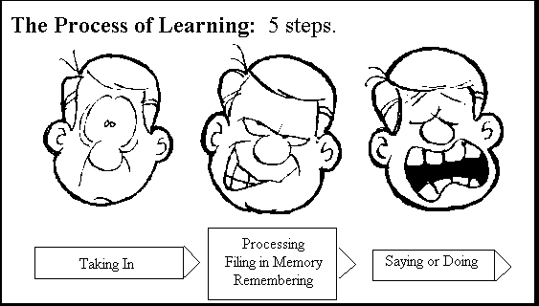

Slide 10
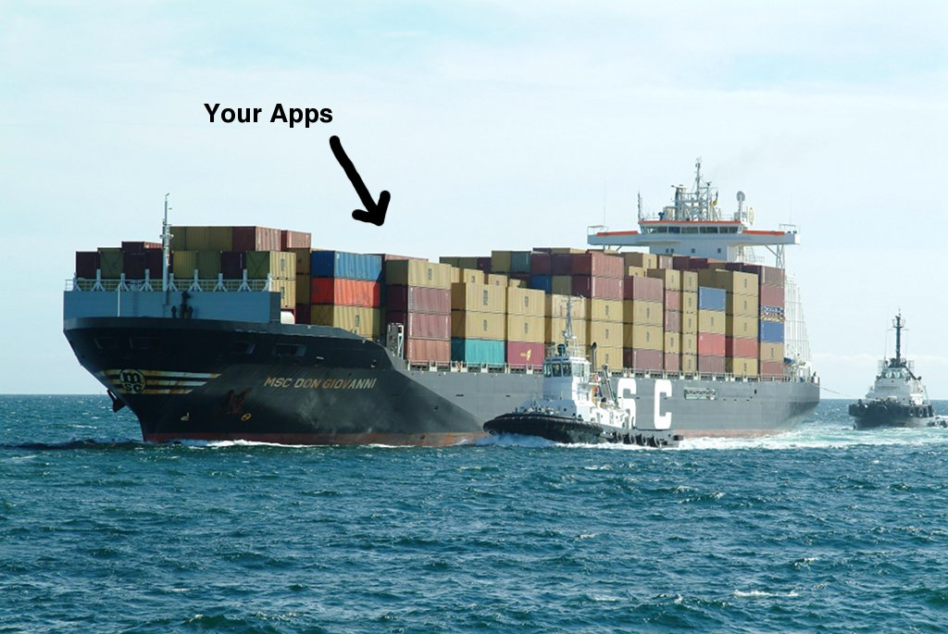

Slide 11
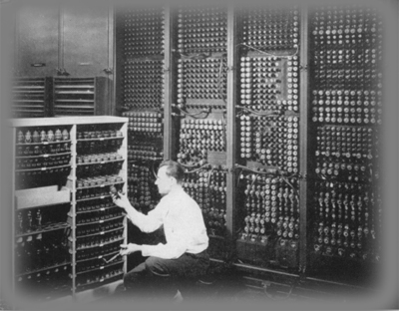

Slide 12
Computers 10 1
Fetch-and-Execute
CPU
Memory
Machine Language
Polling Loops and Interrupts
Multitasking
Process vs. Threads
Virtual Machines

Slide 13
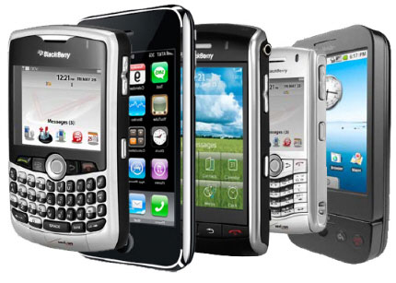

Slide 14
What is Mobile
Phones? Tablets? Apps?
Voice and Data?

Slide 15
Mobile is about Context
Mindset
“I’m microtasking”
“I’m local”
“I’m bored”

Slide 16
The 5 W’s of Mobile
Who: The audience
What: The actions
Where and When: The context
Why: The motivations and goals

Slide 17
Think Different(ly)
What will differentiate your app?
How can you improve upon an app?
How can I make this easier?
Implicit Features
Performance
Efficiency

Slide 18
Think Big, Build Small
A designer knows he has achieved perfection not when there is nothing left to add, but when there is nothing left to take away.
— ANTOINE DE SAINT EXUPÉRY

Slide 19
Ergonomics
How does the app “feel” in the hand
Recognizing the “hot zone”
Space and Proportion
Information presentation
Primary and secondary sources
Scrolling
Hiding

Slide 20
Questions?

Slide 21


Slide 22
What is Android
Application Framework
Dalvik Virtual Machine
Optimized OpenGL ES graphics library
Customized Linux 2.6 kernel
Rich development environment

Slide 23
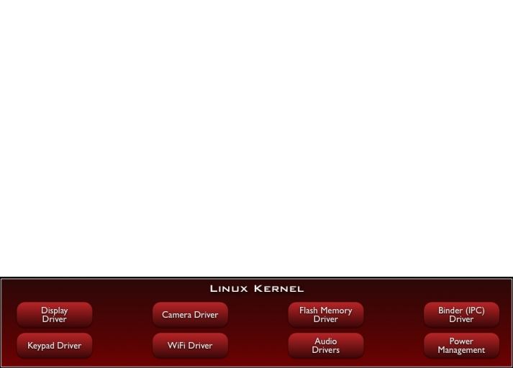
Android Stack

Slide 24
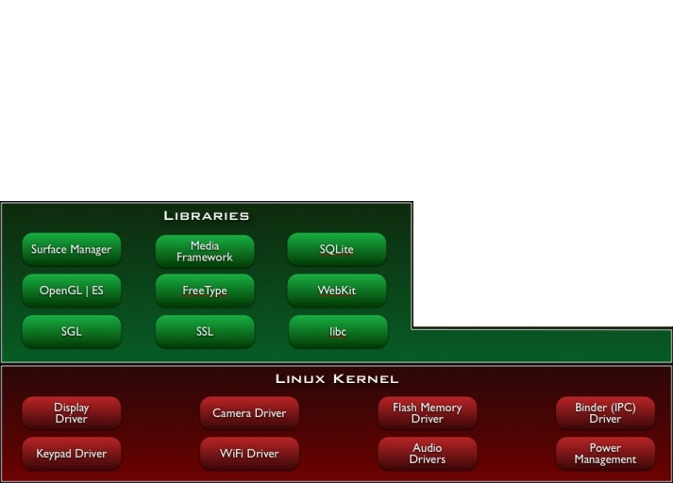
Android Stack
Notes:
libc
Media libraries based on OpenCORE
LibWebCore
SGL for 2D and OpenGL ES for 3D Graphics
SQLite

Slide 25
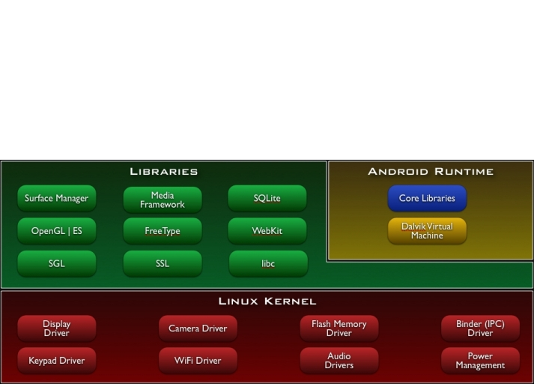
Android Stack

Slide 26
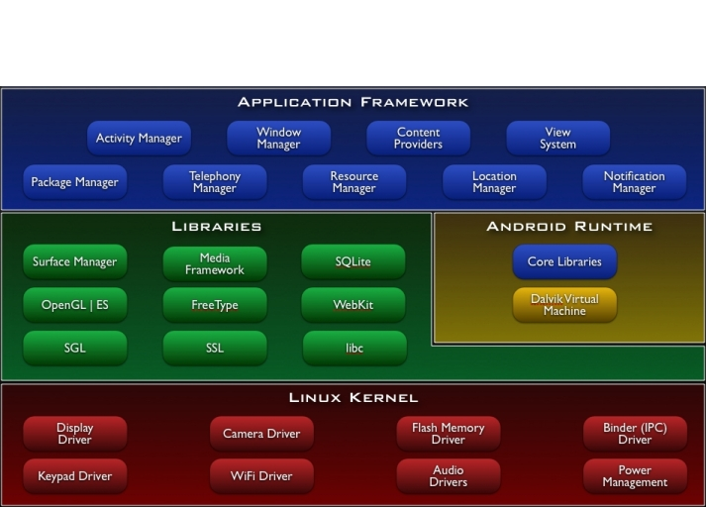
Android Stack
Notes:
Views
Content Providers
Resource Manager
Notification Manager
Activity Manager

Slide 27
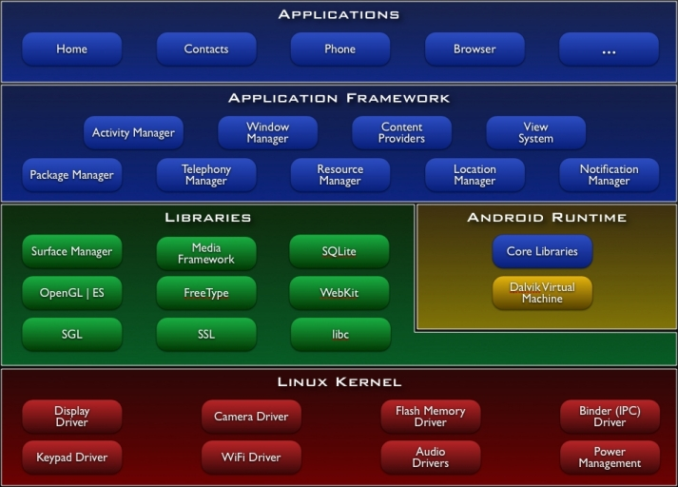
Android Stack

Slide 28
The Core
Dalvik Virtual Machine
Register-based
Runs multiple VMs efficiently
Requires a .class to .dex transformation
JIT (as of Android 2.2)
Each Android Application:
Runs in their own process
Runs on their own VM

Slide 29
Android Application Concepts
Activities
Services
Content Providers
Intents
Resources

Slide 30
Activities
Orchestrates a UI view
Applications are composed of 1-to-Many activities
One activity marked as main and shown first upon launch

Slide 31
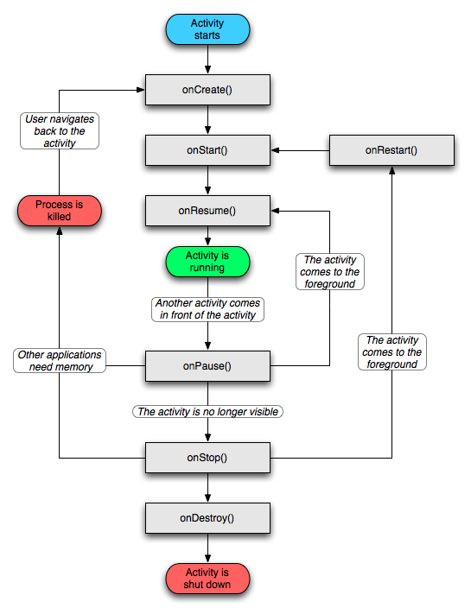

Slide 32
Services
Programs that run in the background (i.e. no user interface or interaction)
Possible to bind to an ongoing service and communicate via exposed interface
Runs in main application process but doesn’t block other components or UI

Slide 33
Content Providers
Queryable application data stores
Only way to share data amongst apps
Android ships with common providers
Audio, video, images, contacts, etc.
Making your application’s data public
Create a new provider
Add your data to existing provider

Slide 34
Intents
Eventing mechanism
Intent objects are passive data that is of interest to the component that is receiving the intent
Filterable

Slide 35
Resources
Images, layout descriptions, binary blobs and string dictionaries
Abstraction layer which helps decouples code
Makes managing assets easier
Localization
Multiple displays
Different hardware configurations
Notes:
“The native Android APIs do not operate directly with filenames, but instead operate on resource IDs. When you compile an Android application that uses resources, the build system will package the resources for distribution and generate a class called "R" (this is an Android convention) that contains the tokens for each one of the resources included.” – http://http://monodroid.net/Documentation/API_Design

Slide 36
Questions?

Slide 37

Object Oriented Programming
Why?
Modularity
Information Hiding
Code re-use
Pluggability
Three Pillars
Encapsulation
Polymorphism
Inheritance

Slide 38
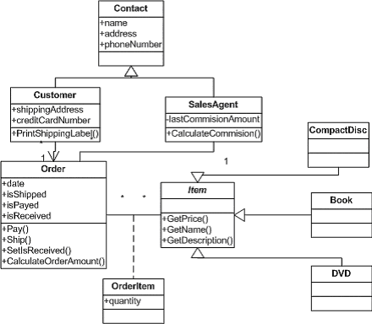

Slide 39
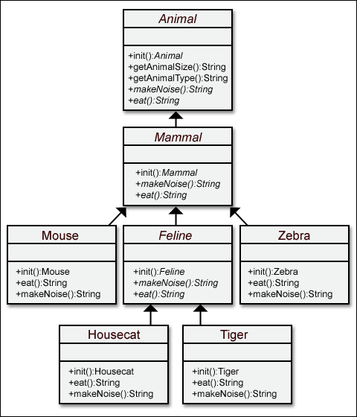

Slide 40


Slide 41
The raw pieces
Source code
Compiler
Byte code
Virtual machine
Run time

Slide 42
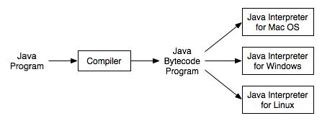

Slide 43
Java Basics
“The Bubble”
Platform Independence
Security
Variables
Primatives
int, float, double, char, etc.
Types
classes

Slide 44
Java Basics
Class Permission and Access
Public
Private
Protected
Methods
Array

Slide 45
Android SDK
Compiler
Simulator
Libraries
Tools and utilities

Slide 46
Summary
Goals
What is Mobile
Touch on the Fundamentals
Development environment

Slide 47
Resources
http://j.mp/java-book
http://j.mp/android-fundamentals
http://www.androidpatterns.com/

Slide 48
There ain’t no rules around here. We’re trying to accomplish something.
— THOMAS EDISON

